Slide 1

IOT HOME AUTOMATION USING RASPBERRY PI
By :
Prashant Jedidiah Kodamala ( 14R01A0524 )
Mounika Pisupati ( 14R01A0539)
Rajdeep Bhattacharjee ( 14R01A0544 )
Aashish Thota ( 14R01A0555)
INTERNAL GUIDE:
Dr. M. JANGA REDDY

Slide 2
CONTENTS
Abstract
Existing System Disadvantages
Proposed System
Working
System Architecture
Modules
Hardware Requirements
Software Requirements
Technologies Used

Slide 3
ABSTRACT
Internet of things is a technology of the future that has already
started to touch our homes.
We propose an IOT based home automation system using raspberry pi that automates home appliances and allows user to control them easily through internet from anywhere over the world.
Our proposed system consists of a microcontroller based circuit that has lights and fans connected to it along with LCD display and Wifi connector interfaced with raspberry pi.
Our system interacts with our online IOT system that is the User
Interface.

Slide 4
After linking with UI, the user is allowed to send load switching commands over IOT to our circuit.
The circuit receives the commands over IOT by connecting to internet using wifi connector.
Then the raspberry processor processes these commands.
After this the processor now processes these instructions to get user commands.
It then displays these on an LCD display.
It operates the loads (lights and fan) for switch them on/off according to desired user commands.
Thus we automate home appliances over internet using raspberry pi.

Slide 5
EXISTING SYSTEM -DISADVANTAGES
Raspberry pi does not have inbuilt wifi.
If we make this project by using rasp 2 we have to connect wifi module.
In existing the IR sensor is used but it does not give proper results so we used PIR sensor.
Has signal limitation.

Slide 6
PROPOSED SYSTEM
This system over comes the signal limitation of the existing system
This system connect the user interface to the raspberry pi system in such a way that it we can switch on the devices connected from any where .
UI is stored in the cloud.

Slide 7
WORKING
You can consider the whole system to be composed of two parts
Server
Client
The server is the web interface consisting of buttons and UI that will allow you to turn ON/OFF a device. It consists of PHP files, Html files and a .txt file (to store data).
The server usually stores information regarding the button press on the page (ON/OFF) on a .txt file
The client side consists of a Raspberry Pi with a relay circuit connected to its GPIO pin.

Slide 8
The pi runs a python program which is used to ‘Post’ a URL link using urllib2.
the URL link is another PHP file called buttonStatus.php. This PHP file serves as an API to read the contents of the text file buttonStatus.txt.
After reading the data, the python program checks if the string obtained is “ON” / “OFF” based on which it switches ON/OFF the relay respectively via its GPIO pin.

Slide 9
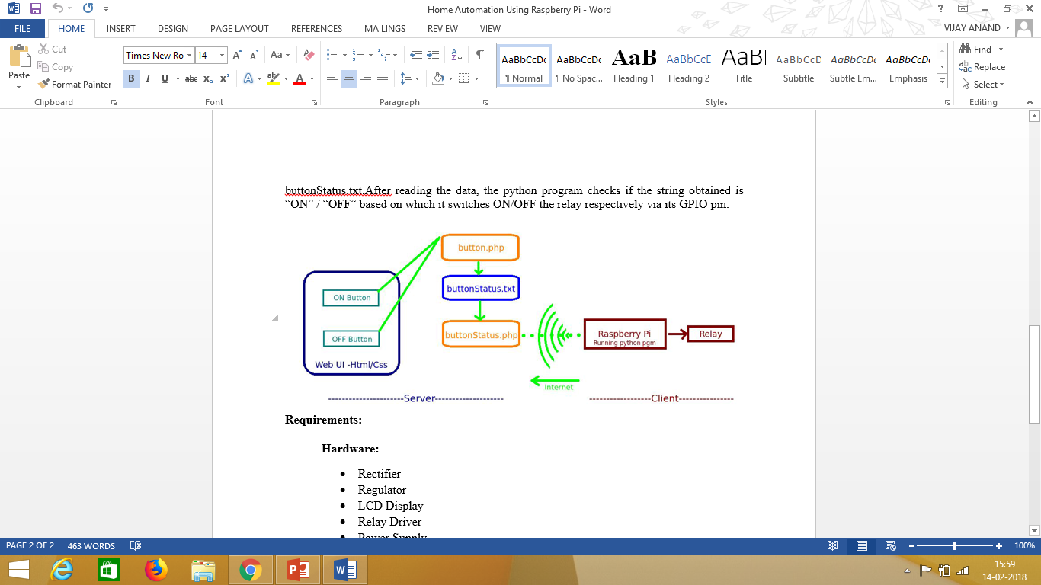
SYSTEM ARCHITECTURE

Slide 10
MODULES
Client
USER INTERFACE
BUTTON.php
BUTTONSTATUS.txt
BUTTONSTATUS.php
Server
RASPBERRY PIE
DEVICES

Slide 11
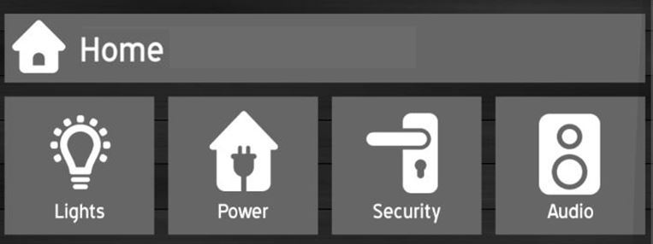
Server

Slide 12
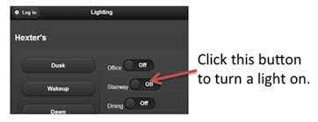

Slide 13
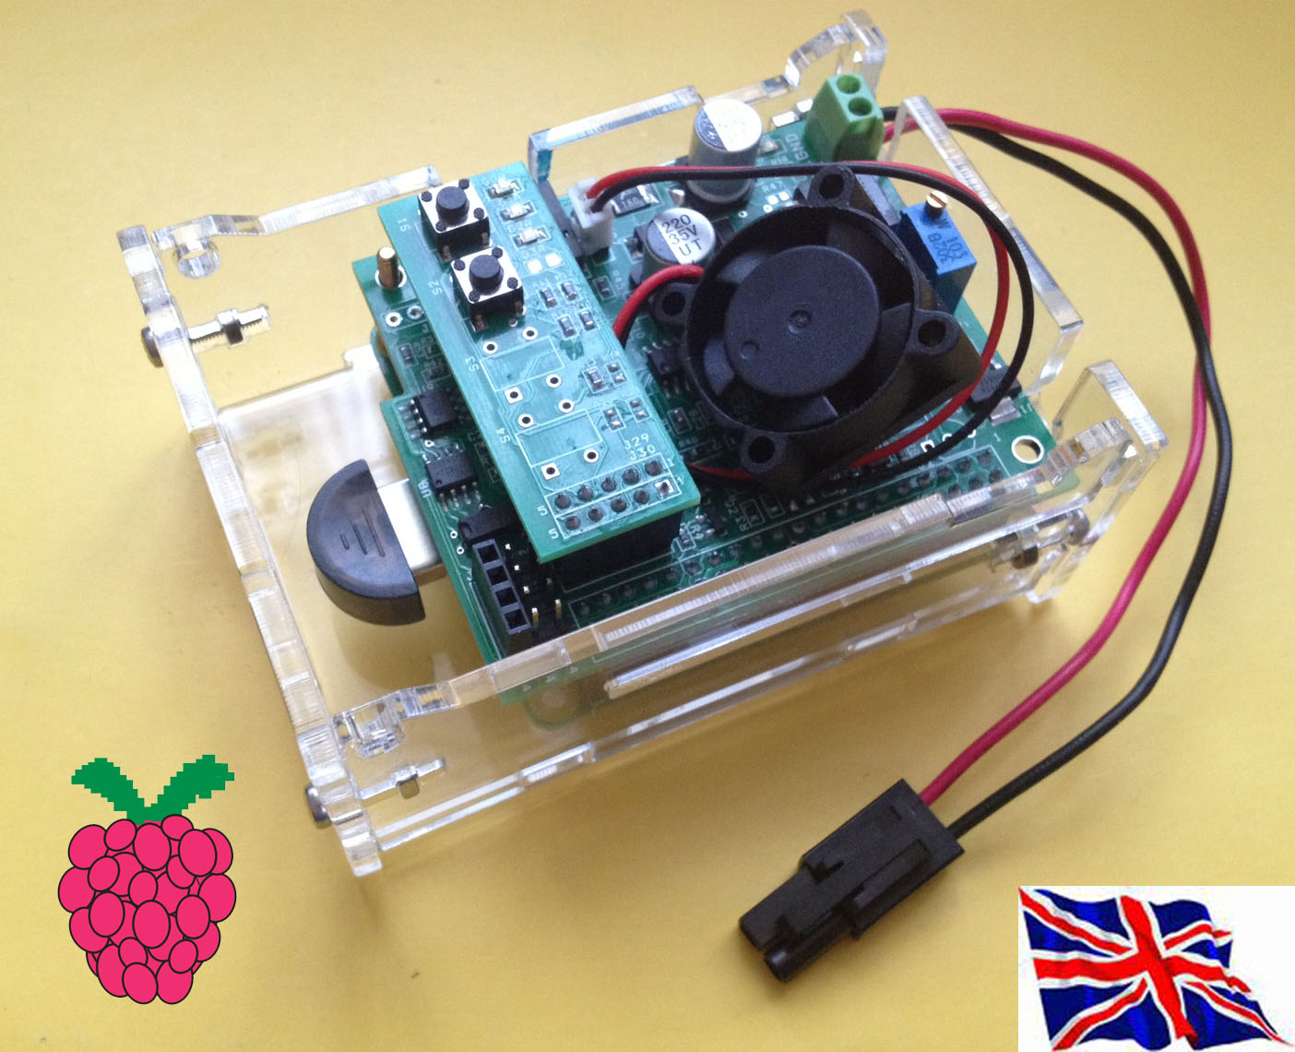
Client

Slide 14
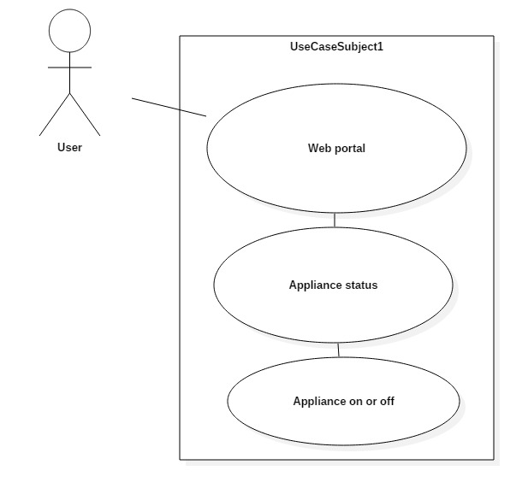
USECASE DIAGRAM

Slide 15
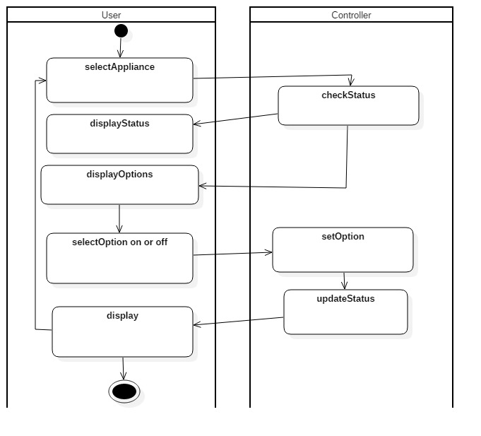
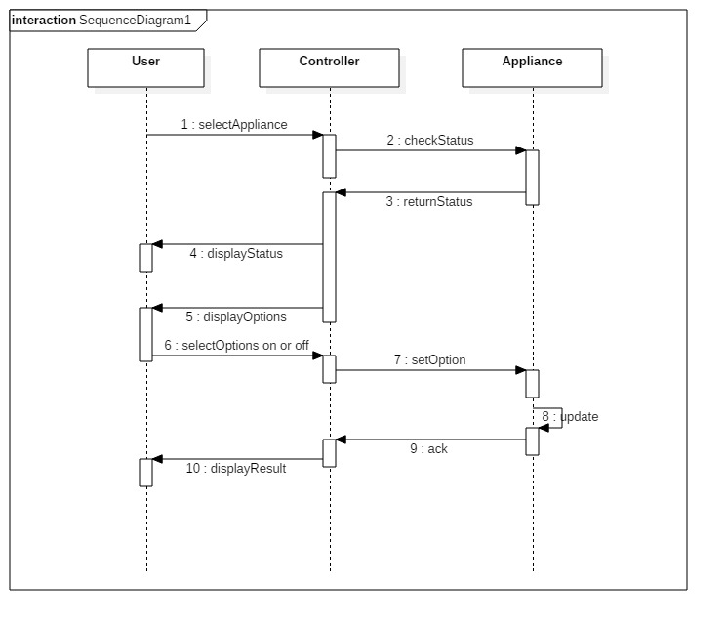
Activity & Sequence Diagram

Slide 16
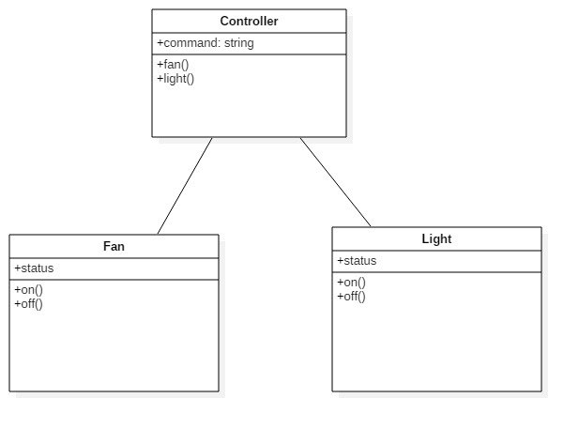
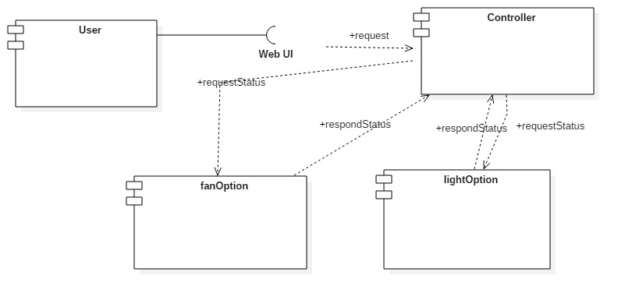
Component and Class Diagram

Slide 17
NON - FUNCTIONAL REQUIREMENTS
SERVER SIDE
Raspberry pie
Led lights
Cooling pad fan
Bread board
Jumper wires
Wifi Connection Modem
CLIENT SIDE
System with 2GB RAM
Ethernet card

Slide 18
FUNCTIONAL REQUIREMENTS
SERVER SIDE
CLIENT SIDE
NOOBS OS
PYCHARM
Xampp
Notepad ++

Slide 19
TECHNOLOGIES USED
CLIENT SIDE
SERVER SIDE
Python Language
Urlib2 package
Rpi.GPIO package
PHP
Angular js
Bootstrap

Slide 20
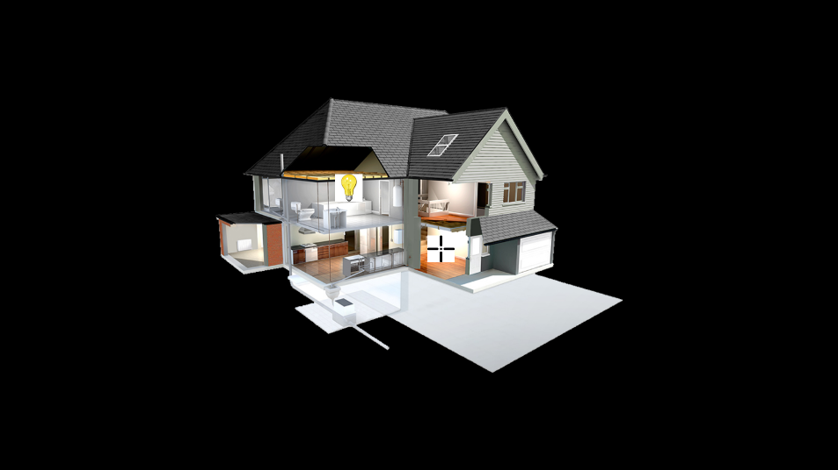

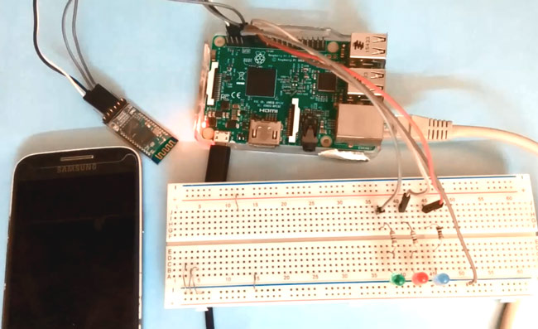
OUTPUT

Slide 21
THANK YOU.!

